Slide 1
Learnmate ai agent
IBM HACKATHON PROJECT
Presented By:
Student name : Deepak Kumar Verma
Course : Masters in computer application
College Name & Department : School of studies in Computer & IT
Pt. Ravishankar Shukla University, Raipur, Chhattisgarh

Slide 2
OUTLINE
Problem Statement
Technology used
Wow factor
End users
Result
Conclusion
Git-hub Link
Future scope
IBM Certifications

Slide 3
Problem Statement No 12
In today's digital world, students have access to thousands of online courses across platforms like Coursera, Udemy, edX, and more. Many students, especially beginners, lack the experience or mentorship to build structured learning paths tailored to:
Their interests (e.g., Frontend Development, Cybersecurity, UI/UX)
Current skill level
Learning pace and preferences
Future career goals
Proposed Solution:
LearnMate is an intelligent AI agent, powered by IBM Granite models, hosted on IBM Cloud Lite, that helps students design and follow personalized, adaptive learning paths for their career goals.

Slide 4
Technology used
IBM cloud lite services
Natural Language Processing (NLP)
Retrieval Augmented Generation (RAG)
IBM Granite model

Slide 5
IBM cloud services used
IBM Cloud Watsonx AI Studio
IBM Cloud Watsonx AI runtime
IBM Cloud Agent Lab
IBM Granite foundation model

Slide 6
Wow factors
Using this Agentic AI, LearnMate, provides students with a highly personalized, dynamic, and adaptive learning experience that goes far beyond static course recommendations. It acts like a virtual mentor, intelligently understanding each student's interests, goals, and current skill level to build a tailored roadmap that evolves with their progress and feedback.
Unique features:
Personalized Learning Paths tailored to user interests, goals, and skill level
Agentic Reasoning using IBM Granite to plan, adapt, and justify course roadmaps
Dynamic Adaptation based on progress, feedback, and changing interests
Multi-Track Learning including both technical skills and soft skills
Modular Course Suggestions from multiple platforms (Coursera, Udemy, etc.)
Autonomous Planning Loop (observe, think, act, reflect) for ongoing mentorship

Slide 7
End users
Students and Learners
Educational Institutions (Secondary Users)
Career Counselors
Mentors (Facilitators)

Slide 8
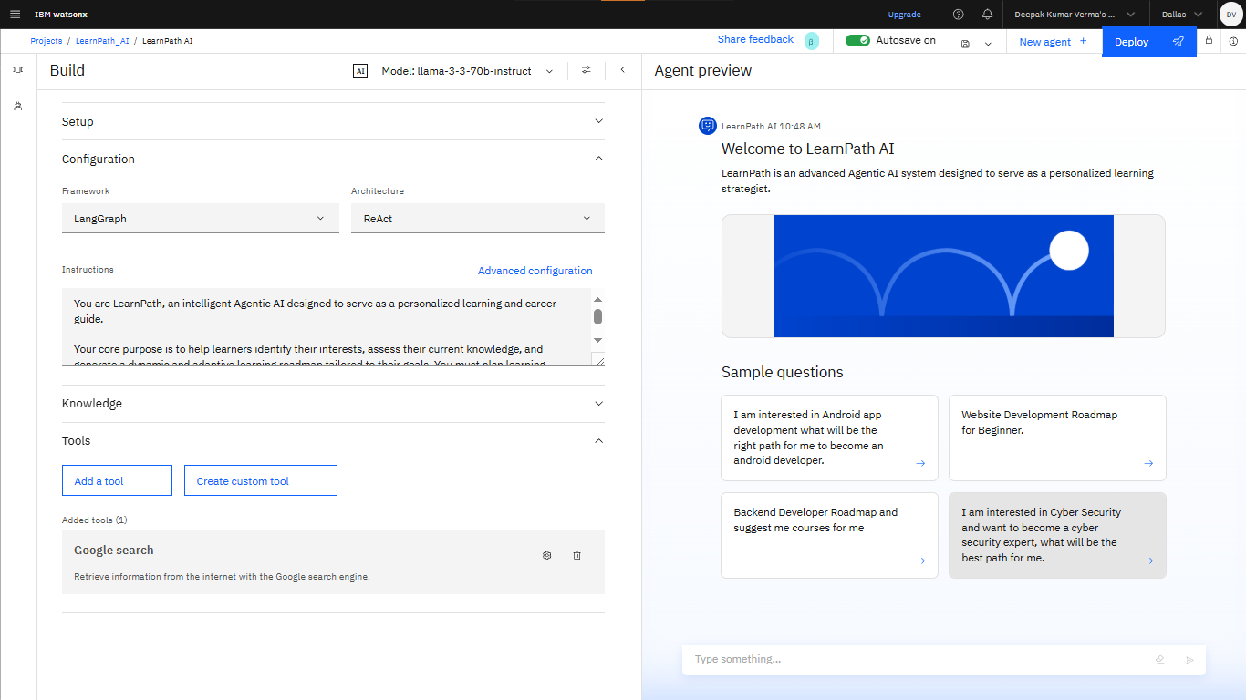
Results

Slide 9
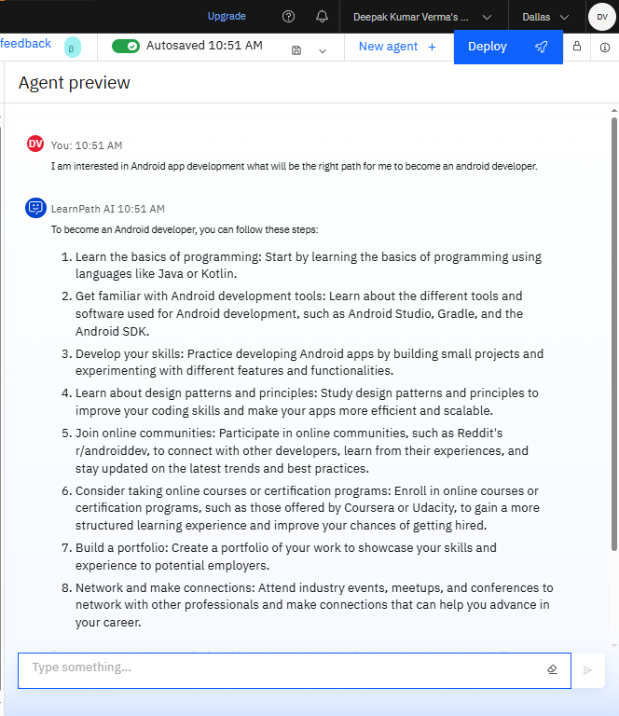
Results

Slide 10
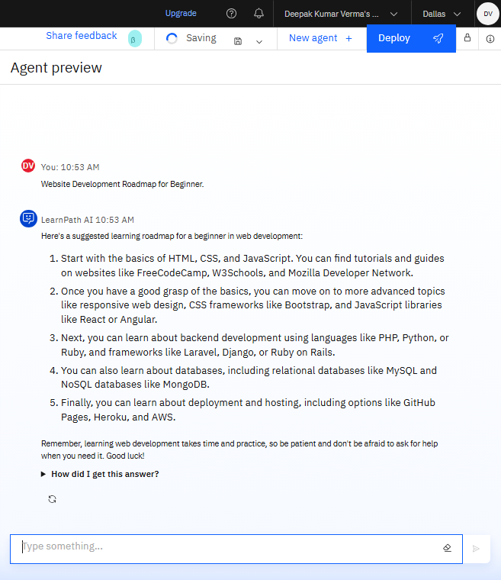
Results

Slide 11
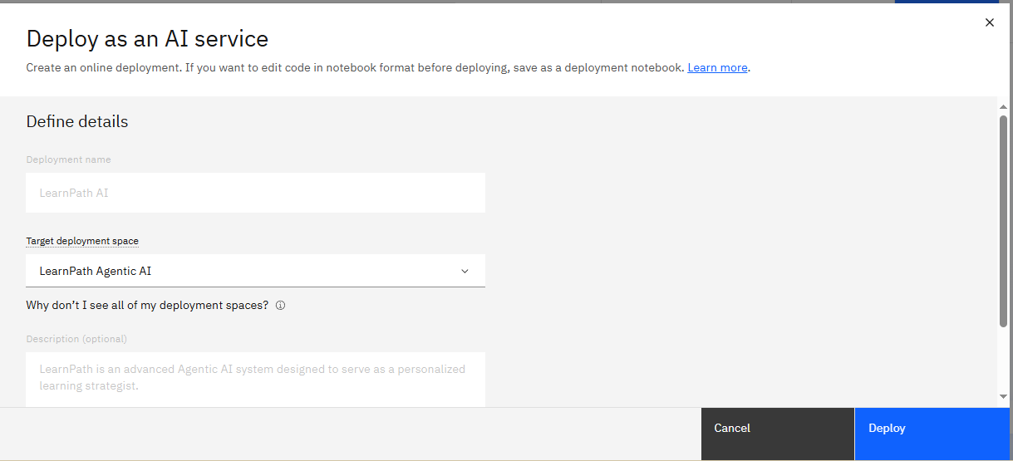
Results
Deployed AI Agent

Slide 12
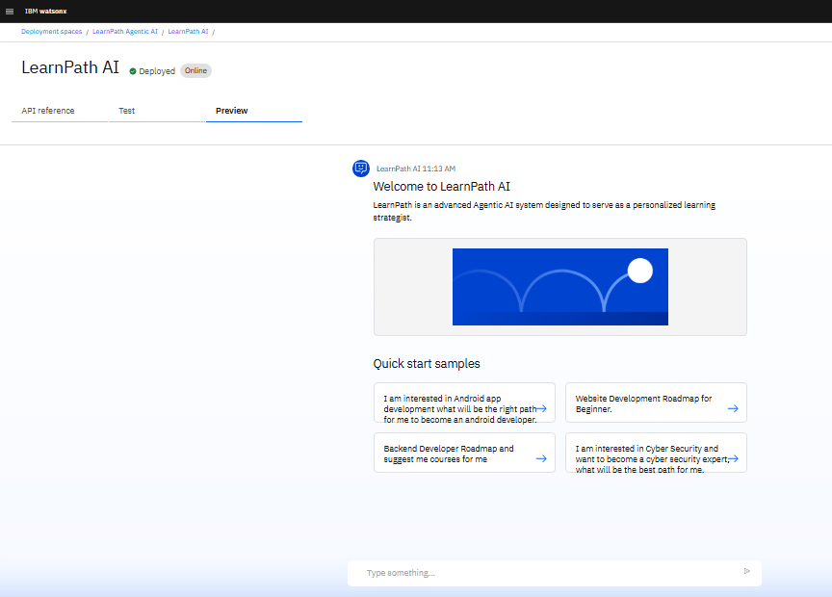
Results
Deployed AI Agent

Slide 13
Conclusion
Personalized Learning Paths tailored to user interests, goals, and skill level
Personalized Planning: Dynamically creates structured, multi-week learning roadmaps with recommended courses and milestones.
Skill Gap Assessment: Quickly identifies a student’s strengths/weaknesses and selects optimal starting points.
Primary Beneficiary: Individual learners seeking structured, personalized, and adaptive course pathways to meet their educational and career goals.

Slide 14
GitHub Link
Deepak-droid9/LearnPath-ai

Slide 15
Future scope
Integration with Learning Management Systems (LMS)
Mobile App Deployment
Multi-Agent Collaboration
Multi-language & Regional Expansion
Career Mapping & Certification Guidance
Partner Ecosystem for Courses
Enterprise Upskilling

Slide 16
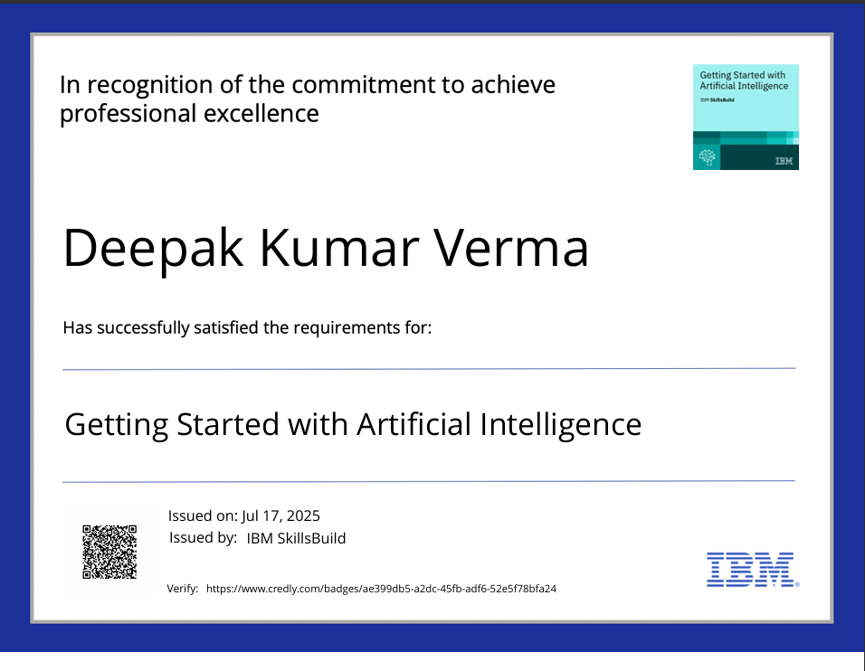
IBM Certifications

Slide 17
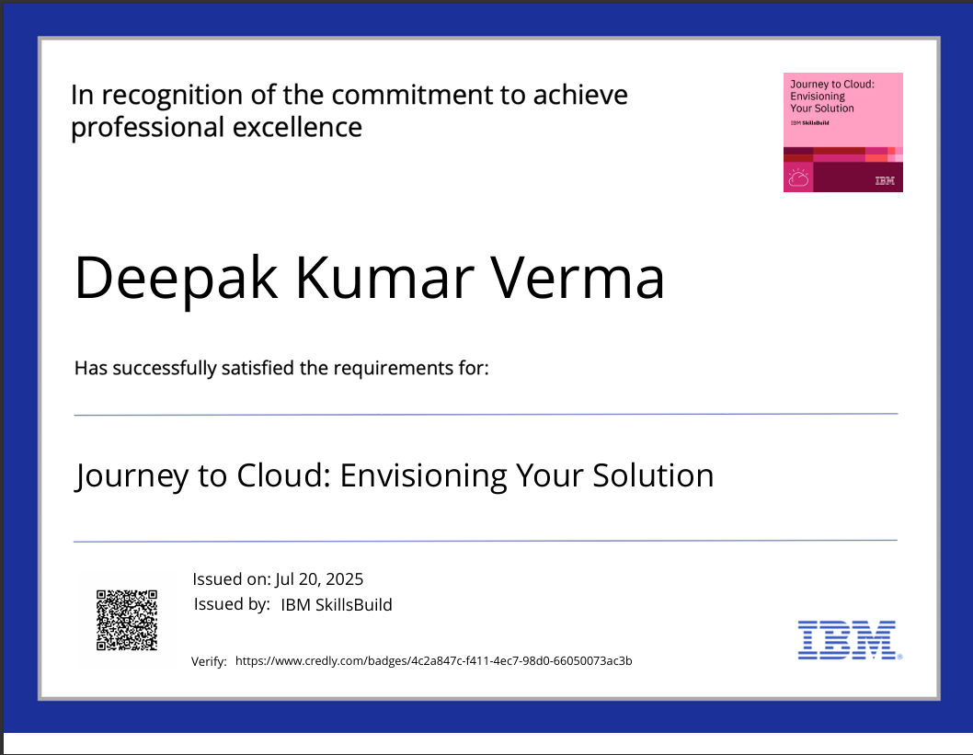
IBM Certifications

Slide 18
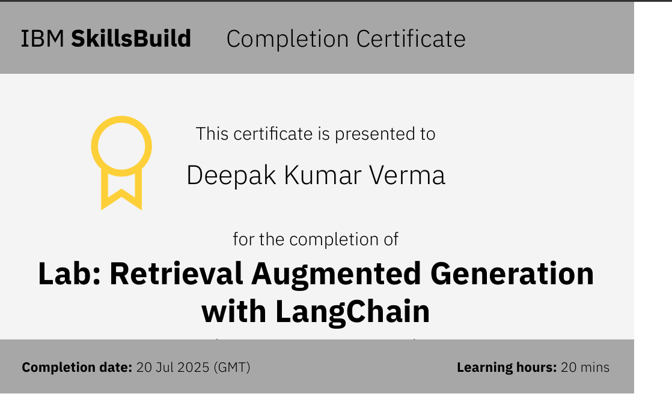
IBM Certifications

Slide 19
THANK YOU

